Slide 1
Cache Coherence Issues

Slide 2
Centralized Shared-Memory Architectures
The observation that the use of large, multilevel caches can substantially reduce the memory bandwidth is the key insight that motivates centralized memory multiprocessors.
Symmetric shared-memory machines usually support the caching of both shared and private data.
Private data are used by a single processor, while shared data are used by multiple processors, essentially providing communication among the processors through reads and writes of the shared data.
When a private item is cached, its location is migrated to the cache, reducing the average access time as well as the memory bandwidth required.
Since no other processor uses the data, the program behavior is identical to that in a uniprocessor.

Slide 3

Centralized Shared-Memory Architectures
When shared data are cached, the shared value may be replicated in multiple caches. In addition to the reduction in access latency and required memory bandwidth, this replication also provides a reduction in contention that may exist for shared data items that are being read by multiple processors simultaneously.
Caching of shared data, however, introduces a new problem: cache coherence.
What Is Multiprocessor Cache Coherence?
The view of memory held by two different processors is through their individual caches, which, without any additional precautions, could end up seeing two different values.
Two different processors can have two different values for the same location. This difficulty is generally referred to as the cache coherence problem.

Slide 4
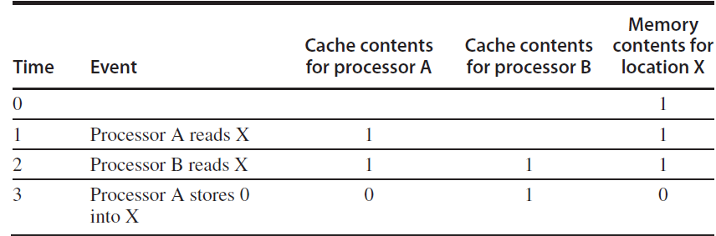
Multiprocessor Cache Coherence
Informally, we could say that a memory system is coherent if any read of a data item returns the most recently written value of that data item.
This simple definition contains two different aspects of memory system behavior, both of which are critical to writing correct shared-memory programs.
The first aspect, called coherence, defines what values can be returned by a read.
The second aspect, called consistency, determines when a written value will be returned by a read.

Slide 5
Multiprocessor Cache Coherence
A memory system is coherent if
1. A read by processor P to location X that follows a write by P to X, with no writes of X by another processor occurring between the write and the read by P, always returns the value written by P.
2. A read by a processor to location X that follows a write by another processor to X returns the written value if the read and write are sufficiently separated in time and no other writes to X occur between the two accesses.
Writes to the same location are serialized; that is, two writes to the same location by any two processors are seen in the same order by all processors.
The first property simply preserves program
The second property defines the notion of what it means to have a coherent view of memory: If a processor could continuously read an old data value, we would clearly say that memory was incoherent.

Slide 6
Multiprocessor Cache Coherence
Suppose we did not serialize writes, and processor P1 writes location X followed by P2 writing location X. Serializing the writes ensures that every processor will see the write done by P2 at some point.
If we did not serialize the writes, it might be the case that some processors could see the write of P2 first and then see the write of P1, maintaining the value written by P1 indefinitely.
The simplest way to avoid such difficulties is to ensure that all writes to the same location are seen in the same order; this property is called write serialization.
The question of when a written value will be seen is important.
If, for example, a write of X on one processor precedes a read of X on another processor by a very small time, it may be impossible to ensure that the read returns the value of the data written, since the written data may not even have left the processor at that point.
The issue of exactly when a written value must be seen by a reader is defined by a memory consistency model

Slide 7
Multiprocessor Cache Coherence
Coherence and consistency are complementary: Coherence defines the behavior of reads and writes to the same memory location, while consistency defines the behavior of reads and writes with respect to accesses to other memory locations.
Make the following two assumptions:
First, a write does not complete (and allow the next write to occur) until all processors have seen the effect of that write.
Second, the processor does not change the order of any write with respect to any other memory access.
These two conditions mean that, if a processor writes location A followed by location B, any processor that sees the new value of B must also see the new value of A.

Slide 8
Basic Schemes for Enforcing Coherence
In a coherent multiprocessor, the caches provide both migration and replication of shared data items.
Coherent caches provide migration, since a data item can be moved to a local cache and used there in a transparent fashion.
This migration reduces both the latency to access a shared data item that is allocated remotely and the bandwidth demand on the shared memory.
Coherent caches also provide replication for shared data that are being simultaneously read, since the caches make a copy of the data item in the local cache.
Replication reduces both latency of access and contention for a read shared data item. Supporting this migration and replication is critical to performance in accessing shared data.
Multiprocessors adopt a hardware solution by introducing a protocol to maintain coherent caches.

Slide 9
Basic Schemes for Enforcing Coherence
The protocols to maintain coherence for multiple processors are called cache coherence protocols. Key to implementing a cache coherence protocol is tracking the state of any sharing of a data block.
There are two classes of protocols in use, each of which uses different techniques to track the sharing status:
■ Directory based—The sharing status of a particular block of physical memory is kept in one location, called the directory.
There are two very different types of directory-based cache coherence.
  In an SMP, we can use one centralized directory, associated with the memory or some other single serialization point, such as the outermost cache in a multicore.
  In a DSM, it makes no sense to have a single directory, since that would create a single point of contention and make it difficult to scale to many multicore chips given the memory demands of multicores with eight or more cores. Distributed directories are more complex than a single directory.

Slide 10
Basic Schemes for Enforcing Coherence
■ Snooping—Rather than keeping the state of sharing in a single directory, every cache that has a copy of the data from a block of physical memory could track the sharing status of the block.
In an SMP, the caches are typically all accessible via some broadcast medium (e.g., a bus connects the per-core caches to the shared cache or memory), and all cache controllers monitor or snoop on the medium to determine whether or not they have a copy of a block that is requested on a bus or switch access.

